Slide 1

Styling with CSS
Selectors and Properties
Separate CSS File
Combined Rules
Inheritance
Class Selectors

Slide 2

See Also
https://www.youtube.com/watch?v=qKoajPPWpmo&list=PLr6-GrHUlVf8JIgLcu3sHigvQjTw_aC9C
https://www.w3schools.com/css/

Slide 3

In the Book
Chapter 7:
Getting Started With CSS

Slide 4
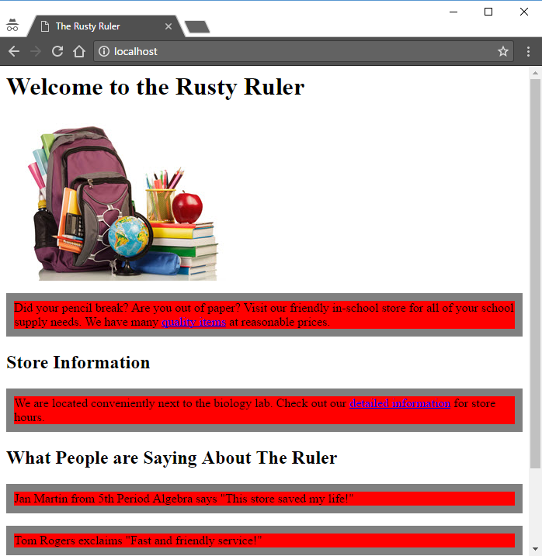
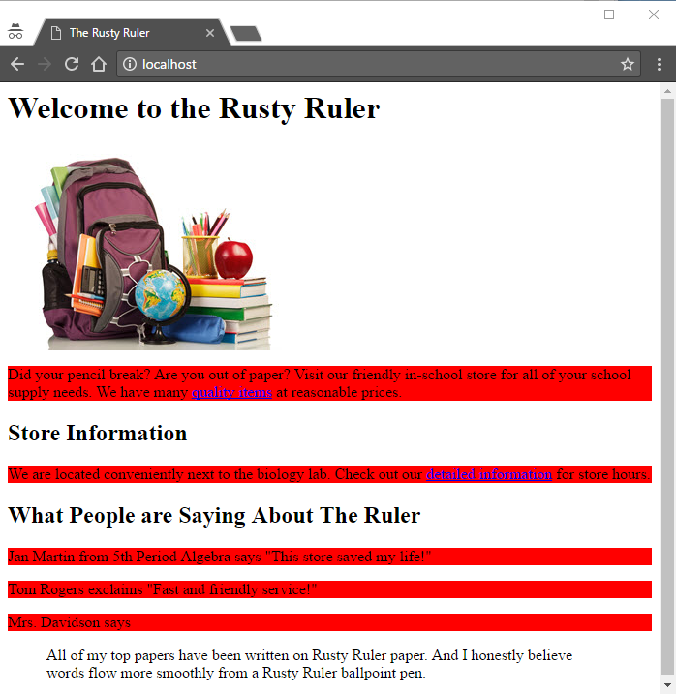
CSS Rules
<html>
<head>
<title>The Rusty Ruler</title>
<style>
p {
background-color: red;
border: 1px solid gray;
}
</style>
</head>
<body>
...
<p>Did your pencil ...</p>
...
</body>
</html>

Slide 5
CSS Syntax
Colon
Selector
Braces
Semicolon
p {
background-color: red;
border: 1px solid gray;
}
h1 {
background-color: blue;
}
h2{background-color:green;}
Property
Value
Rule
Spacing optional

Slide 6
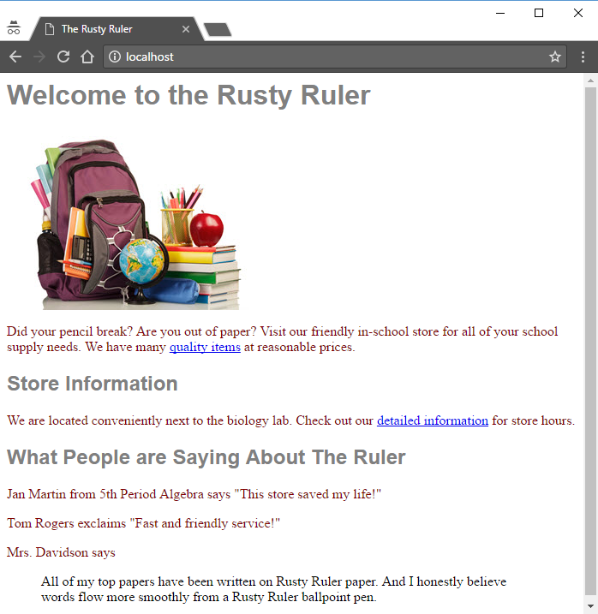
Styling the Rusty Ruler
<style>
p {
color: maroon;
}
h1 {
font-family: sans-serif;
color: gray;
}
h2 {
font-family: sans-serif;
color: gray;
}
</style>

Slide 7

Styling the Rusty Ruler
<style>
p {
color: maroon;
}
h1, h2 {
font-family: sans-serif;
color: gray;
border-bottom: 1px solid black;
}
</style>

Slide 8
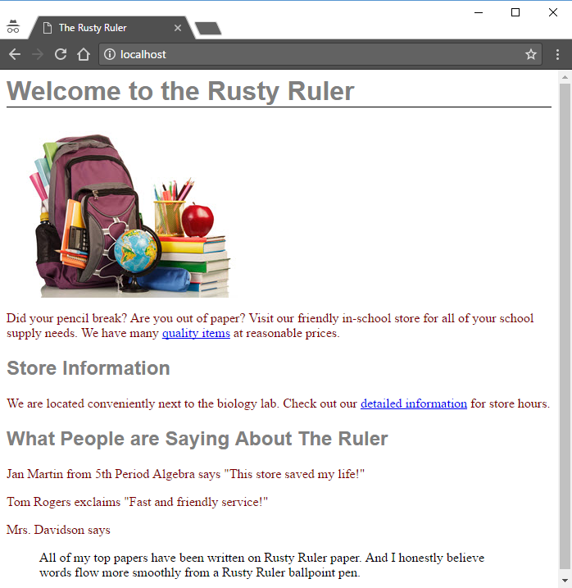
Styling the Rusty Ruler
<style>
p {
color: maroon;
}
h1, h2 {
font-family: sans-serif;
color: gray;
}
h1 {
}
</style>
border-bottom: 1px solid black;

Slide 9
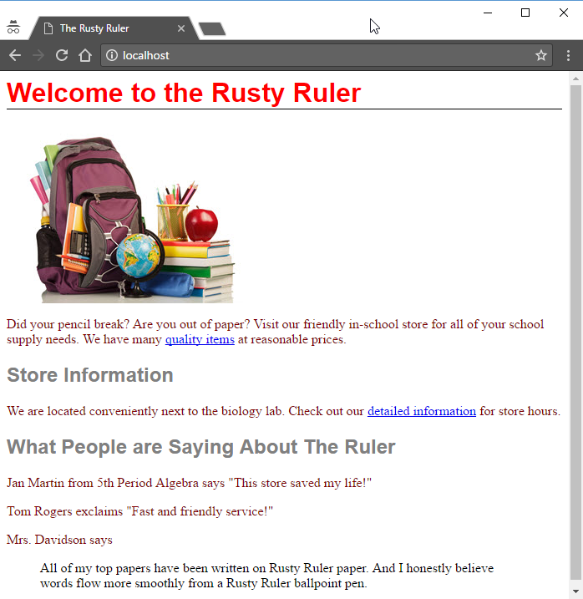
Conflicting Rules
h1 {
color: blue;
}
h1 {
color: red;
}
h1 {
colo: green;
}
The last value wins
Unknown properties are silently ignored

Slide 10
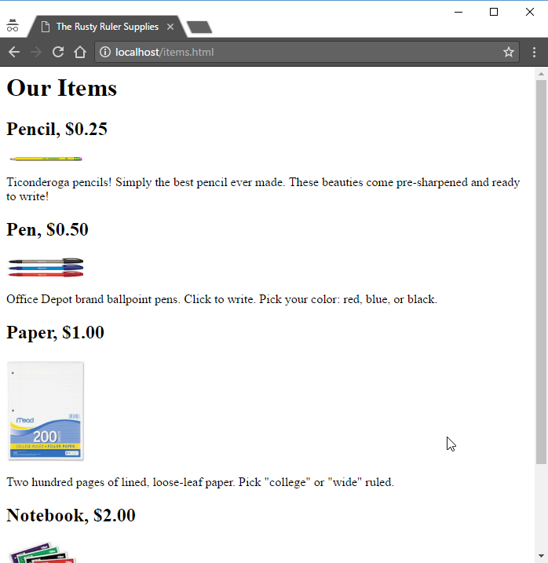
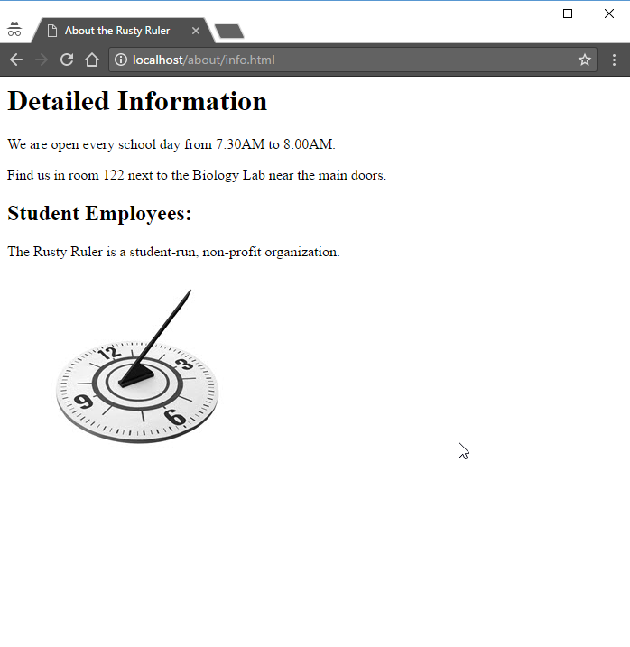
Sharing CSS
We could copy/paste the <style> into all pages.
Any future changes would have to be made to all of them.
Instead, we tell all of our pages to reference a separate (common) CSS file.

Slide 11
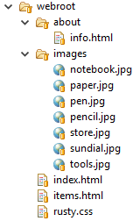
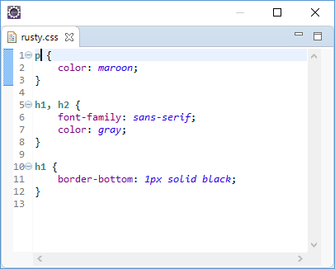
The <link> Element
Extension “.css”
No <style> wrapper
<head>
<title>The Rusty Ruler Supplies</title>
<link rel="stylesheet" href="rusty.css">
</head>

Slide 12
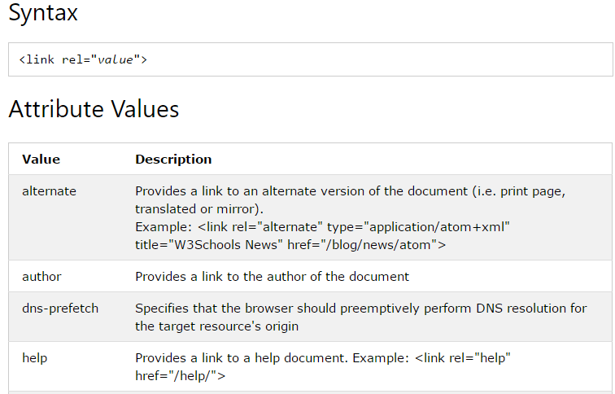
The <link> Element
<link rel="stylesheet" href="rusty.css">
Path to the resource
Just like <a>
Could be external

Slide 13
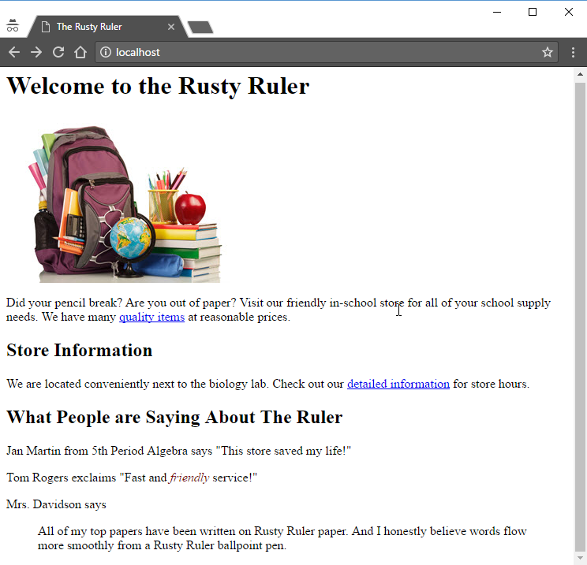
Inheritance
em {
color: maroon;
}
html
body
h1
p
h2
p
em

Slide 14

Inheritance
p {
color: maroon;
}
html
body
h1
p
h2
p
em

Slide 15

Inheritance
body {
font-family: "Comic Sans MS";
}
p {
color: maroon;
}
h1, h2 {
color: gray;
}
h1 {
border-bottom: 1px solid black;
}
html
body
h1
p
h2
p
a
em

Slide 16
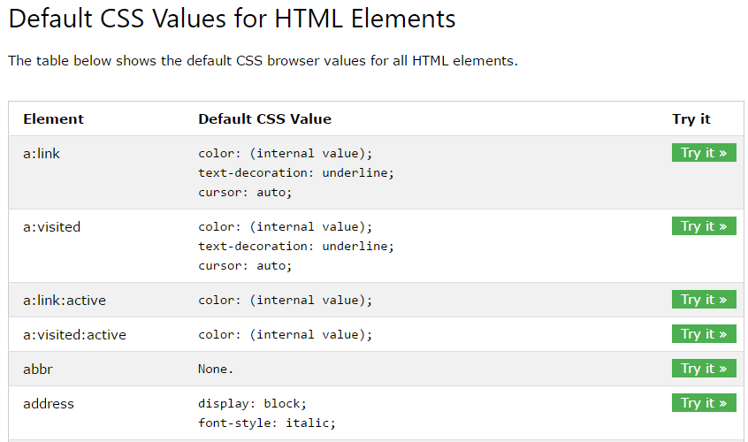
CSS Defaults
https://www.w3schools.com/cssref/css_default_values.asp

Slide 17
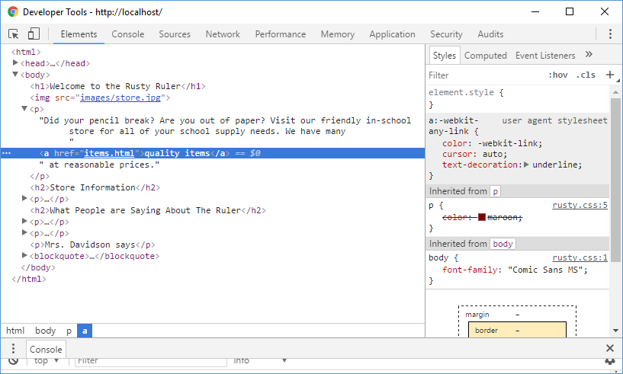
Surfing the DOM

Slide 18
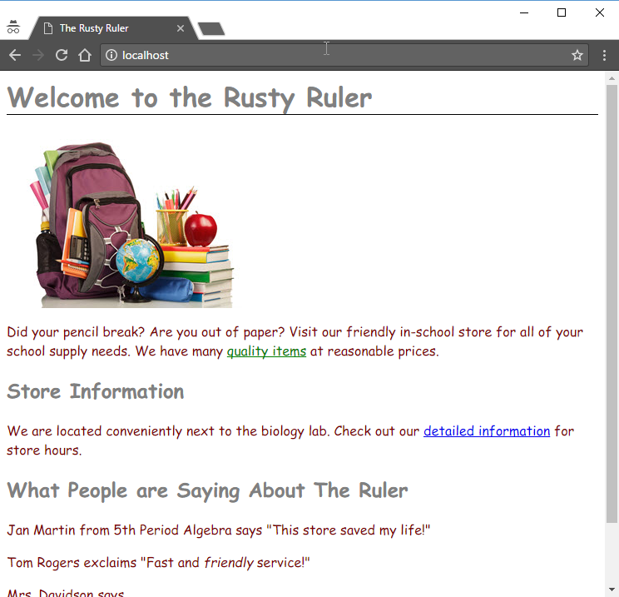
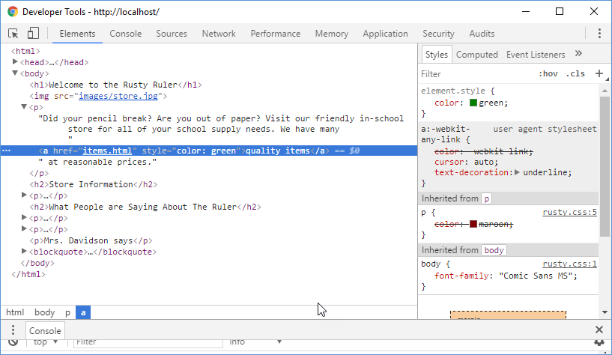
Surfing the DOM
<h1>Welcome to the Rusty Ruler</h1>
<p>Did your pencil break
<a href="items.html" style="color: green">quality items</a>
</p>

Slide 19
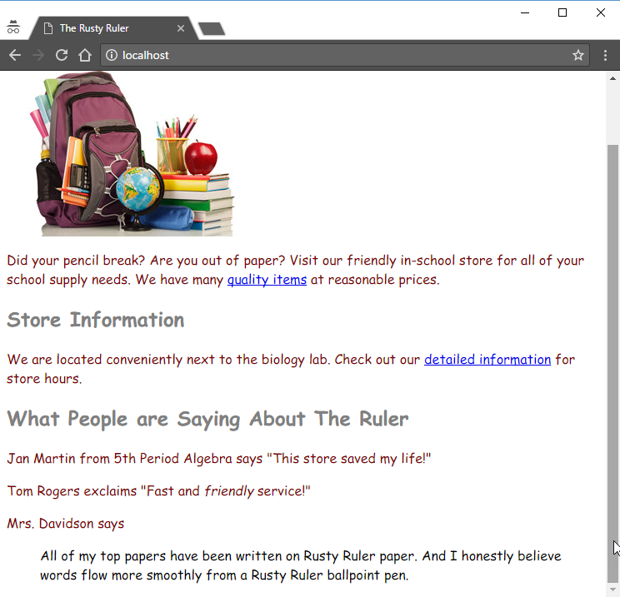
Element Classes
HTML allows you to define classes (types) of things.
Then you apply styles to the classes of things.
10px Border, Red Text
Important Things
Green Text
Crazy Things
Great Things
Times Roman, Blue Text

Slide 20
Assigning Classes
body {
font-family: "Comic Sans MS";
}
h1 {
border-bottom: 1px solid black;
}
.greatThing {
font-family: "Times Roman";
color: blue;
}
.crazyThing {
color: green;
}
.importantThing {
color: red;
border: 10px solid red;
}
<h2 class="importantThing">Store Information</h2>
<h2>What People are Saying About The Ruler</h2>
<p>Jan Martin says
<q class="greatThing">This store saved</q>
</p>
<p>Tom <q>Fast and <em>friendly</em> service!</q></p>
<p class="crazyThing">Mrs. Davidson says</p>
<blockquote class="greatThing">top papers </blockquote>
Class Selectors
Start with “.”
The rule matches every element with that class

Slide 21
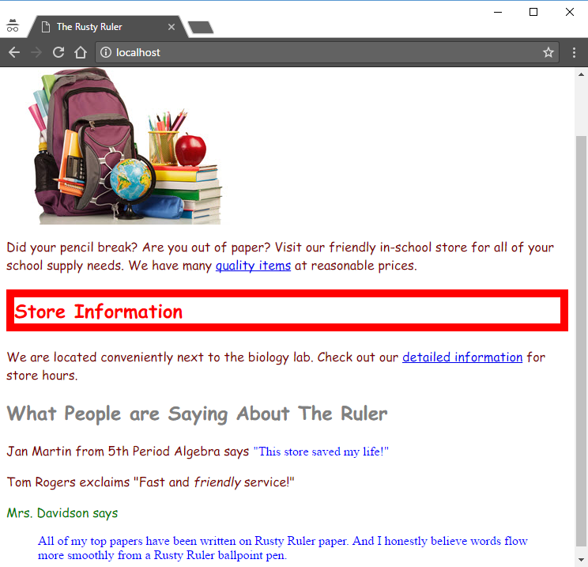
Assigning Classes
<h2 class="importantThing">Store Information</h2>
<h2>What People are Saying About The Ruler</h2>
<p>Jan Martin says
<q class="greatThing">This store saved</q>
</p>
<p>Tom <q>Fast and <em>friendly</em> service!</q></p>
<p class="crazyThing">Mrs. Davidson says</p>
<blockquote class="greatThing">top papers </blockquote>

Slide 22
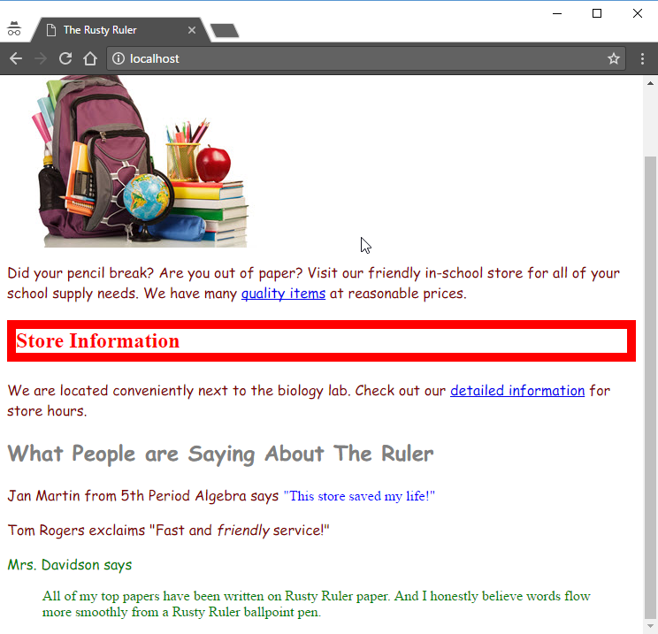
Multiple Classes
<h2 class="importantThing greatThing">Store Information</h2>
<blockquote class="greatThing crazyThing">top papers </blockquote>
.greatThing {
font-family: "Times Roman";
color: blue;
}
.crazyThing {
color: green;
}
.importantThing {
color: red;
border: 10px solid red;
}
Selectors are applied one by one from the CSS file after the HTML loads.

Slide 23

Tinkering
Add a separate CSS file to one of your HTML files.
Google CSS attributes and experiment with different properties and values. developer tools.
Visit your favorite retail site. Open the developer tools and surf the DOM. Try replacing some of the CSS values through the developer tools.

